Slide 1
Project presentation 2
Attend-in (Team 8)
Group members: Duc Pham, Jalen Davis, Md Rifat Uddin, Jason Tran
Instructor: Dr. William Gregory Johnson

Slide 2
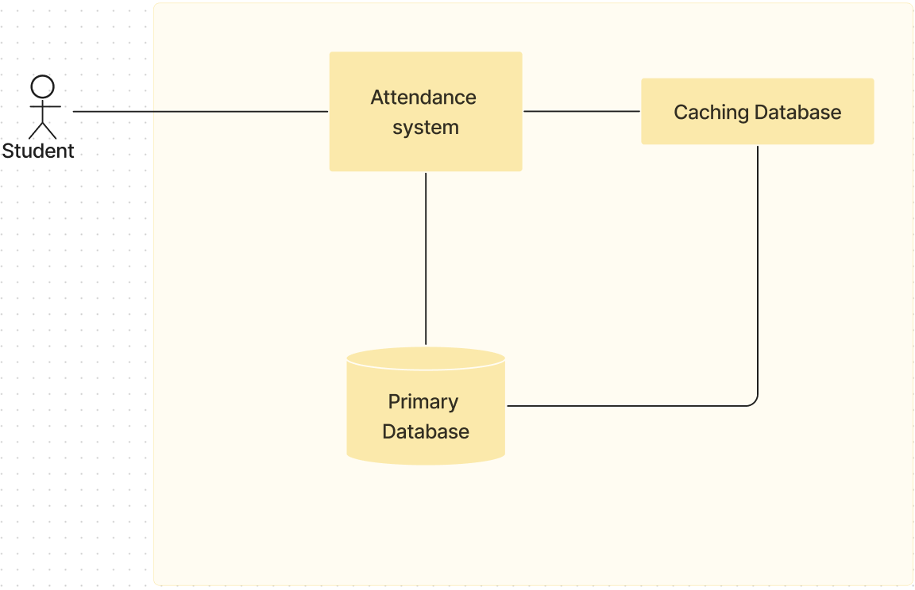
Use case Diagram 1

Slide 3
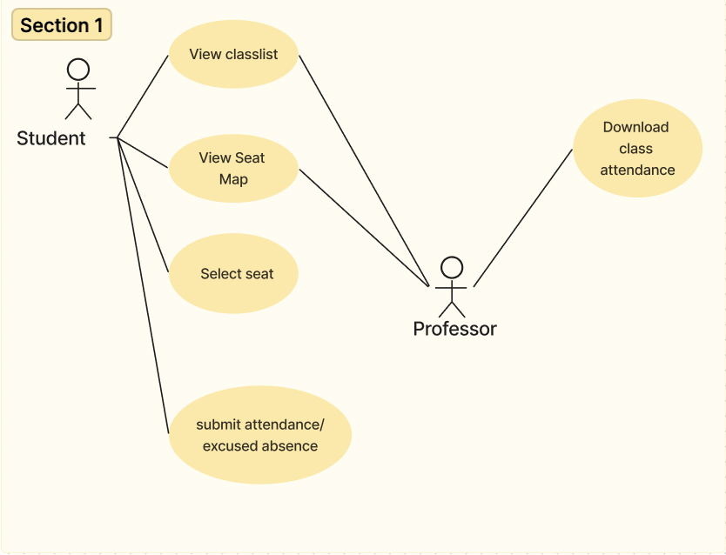
Use case Diagram 2

Slide 4
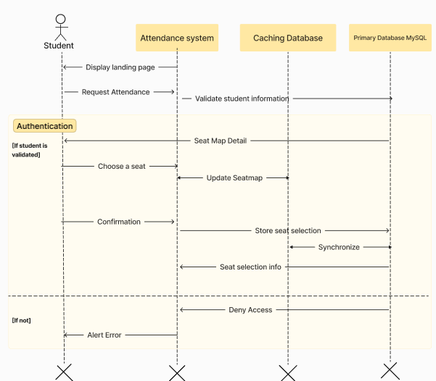
Sequence Diagram
For seat selection process

Slide 5
Test Case Scenarios
The student can not access the seat map if they are not within the classroom area
Use hard-coded locations
Check if system:
Allows attendance submission outside the classroom area (False positive)
Deny attendance submission inside the classroom area (False negative)
The student can see what seats other students have selected in their respective browser
Simulate multiple students concurrently taking attendance by opening many tabs in one device with each tab representing a student’s connection.
Check if:
two students can select the same seat
Students’ Seatmap will be updated when one of the students selects a seat

